Slide 1
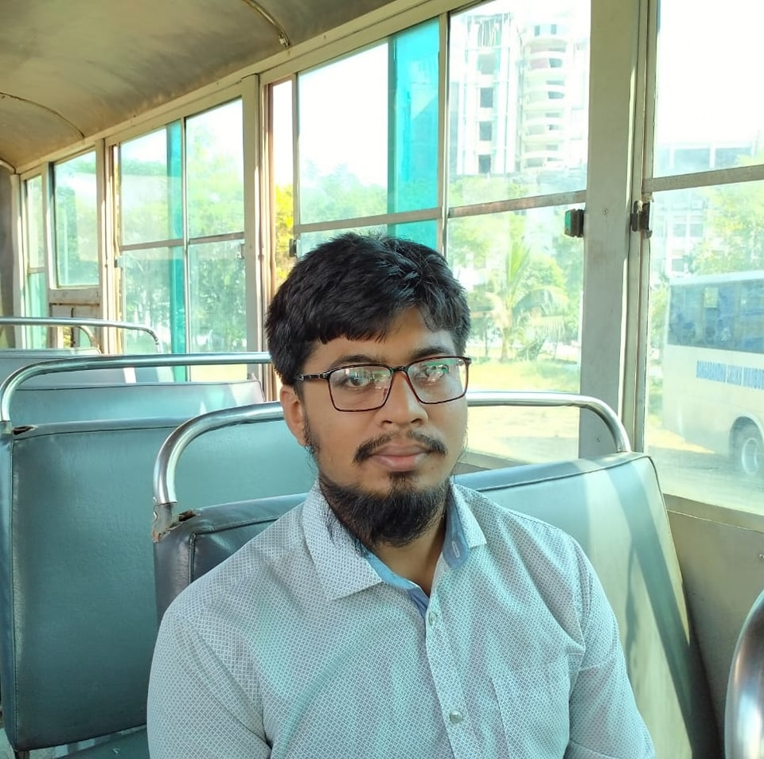
About Me
Yeasin Arafat
ID: 18CSE203
3rd Year, 2nd Semester
Department of CSE, BSMRSTU.

Slide 2

Honorable Supervisor
Dr. Mrinal Kanti Baowaly
Associate Professor
Department of CSE, BSMRSTU.

Slide 3
About Course
Course Code: CSE378
Course Title: Project
Level: 3rd Year, 2nd Semester

Slide 4
About “Car Rental”
"Car Rental" is an online platform to reserve, rent, and manage vehicles seamlessly.
The goal of a car rental system is to simplify vehicle reservations, rentals, and fleet management.

Slide 5
Car Rental :: Module
Customer
Reservation Management
User Profiles
Secure Payment Processing
Support and Assistance
Employe/Admin
Vehicle management(add/remove)
Driver/other Employe Management
Reservation Management

Slide 6
Car Rental :: Technology & Tools
Programming Language:
PHP
Scriptiong Language(HTML, CSS, JS)
API(Bkash)
Tools
MySql
Visual Studio Code
MySql Workbench

Slide 7
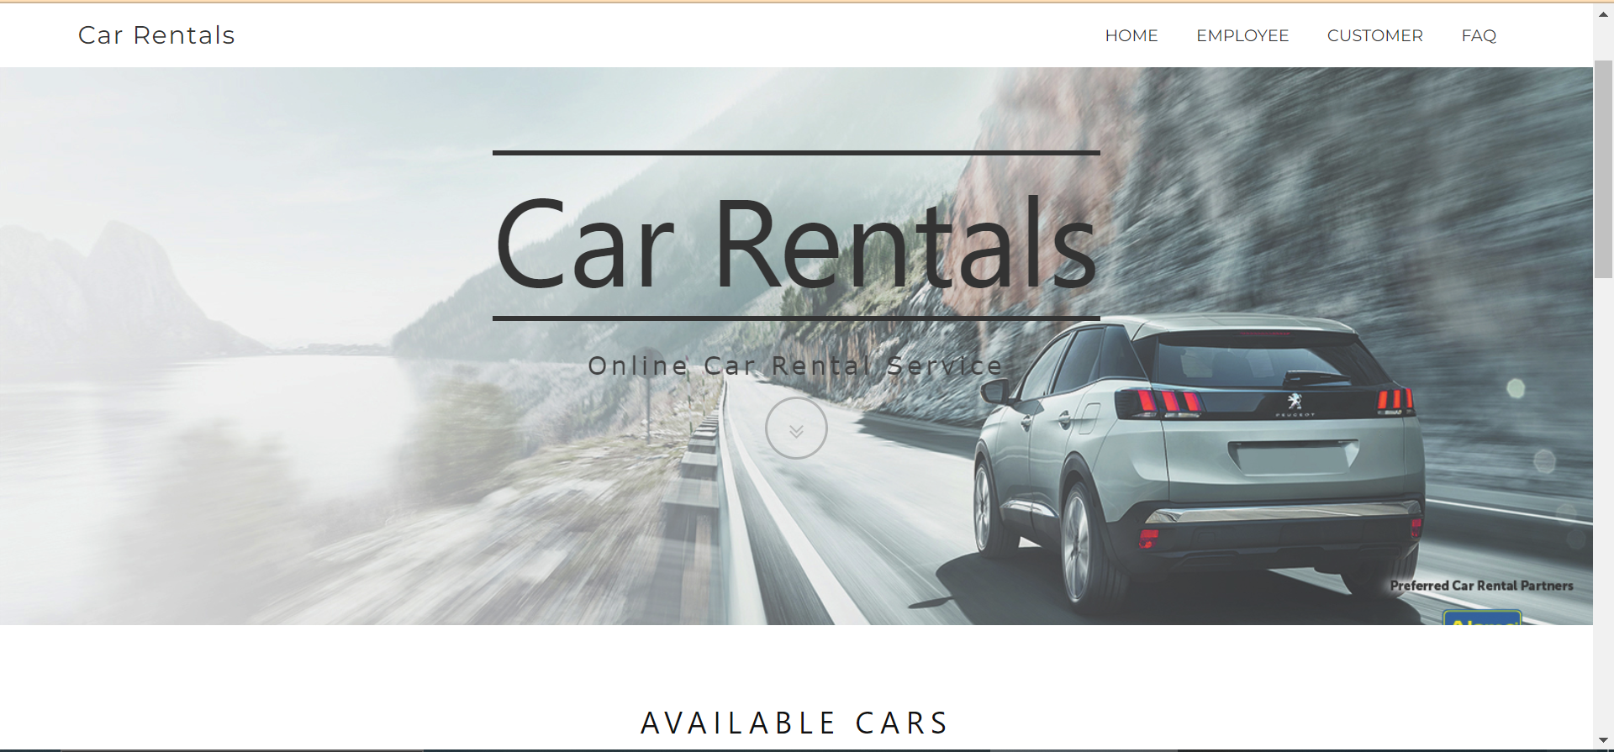
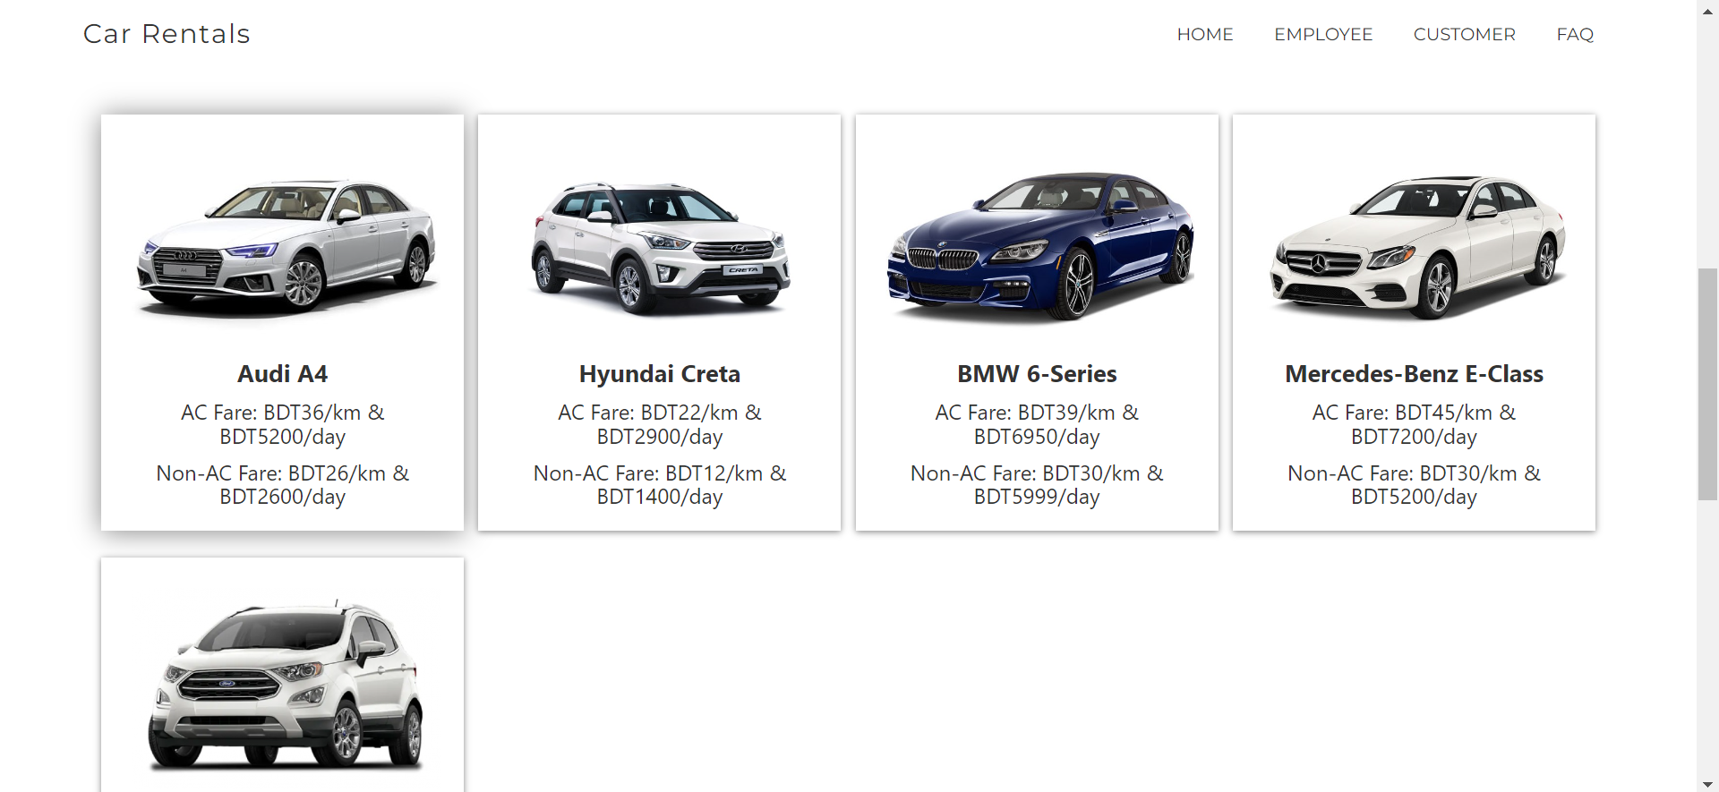
Car Rental :: Home Page

Slide 8
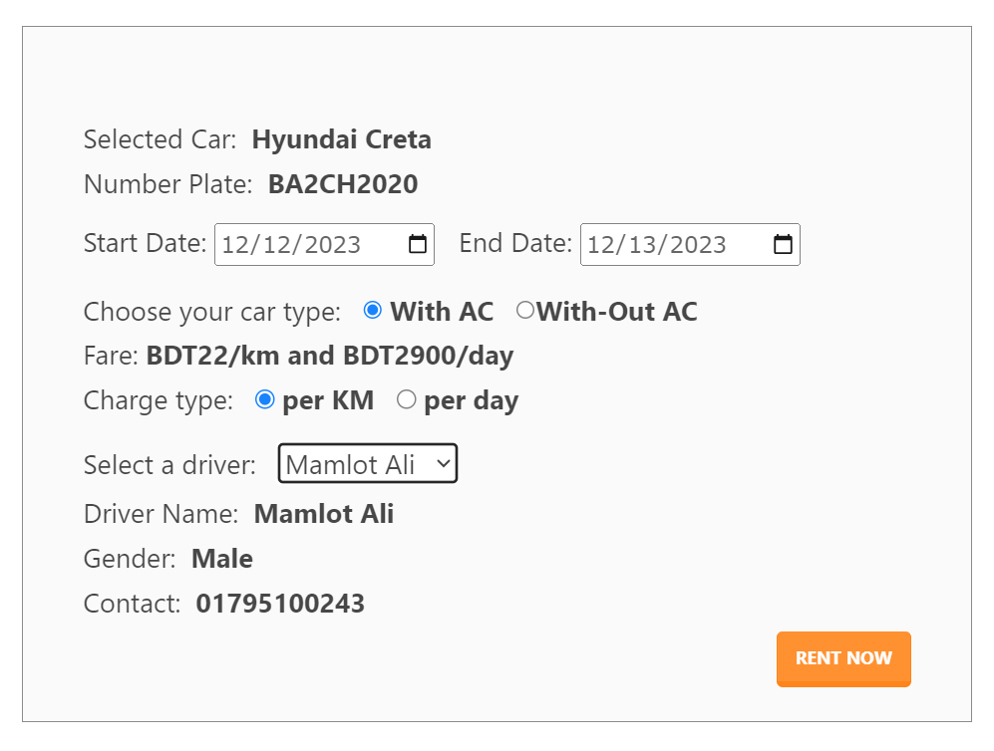
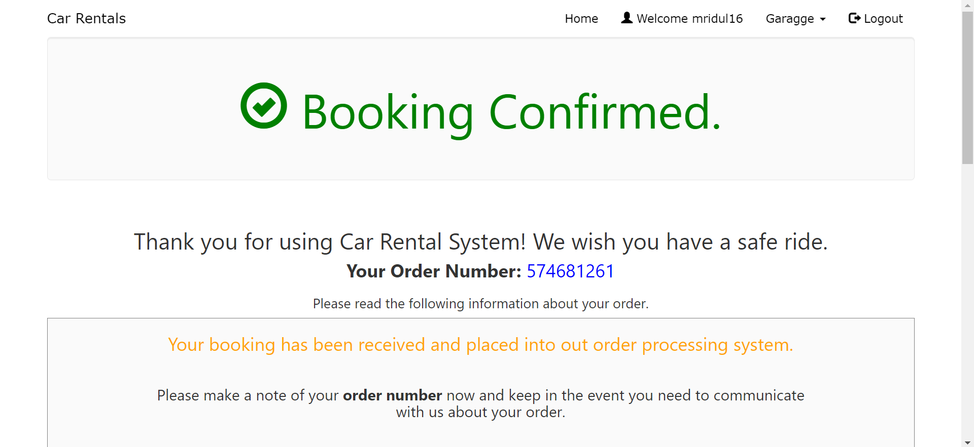
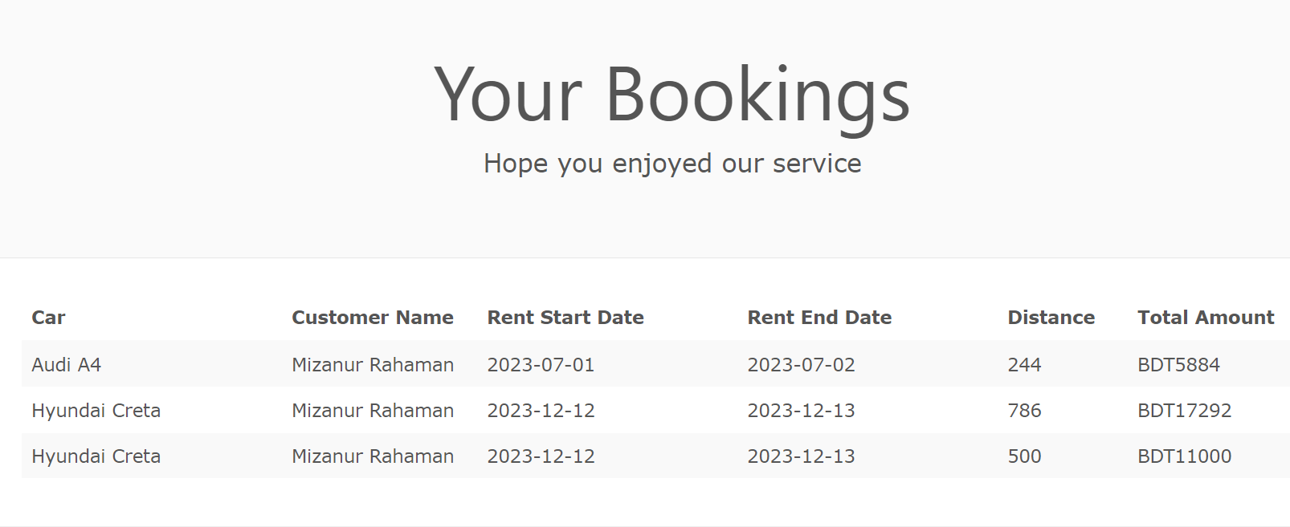
Car Rental ::Booking Page

Slide 9
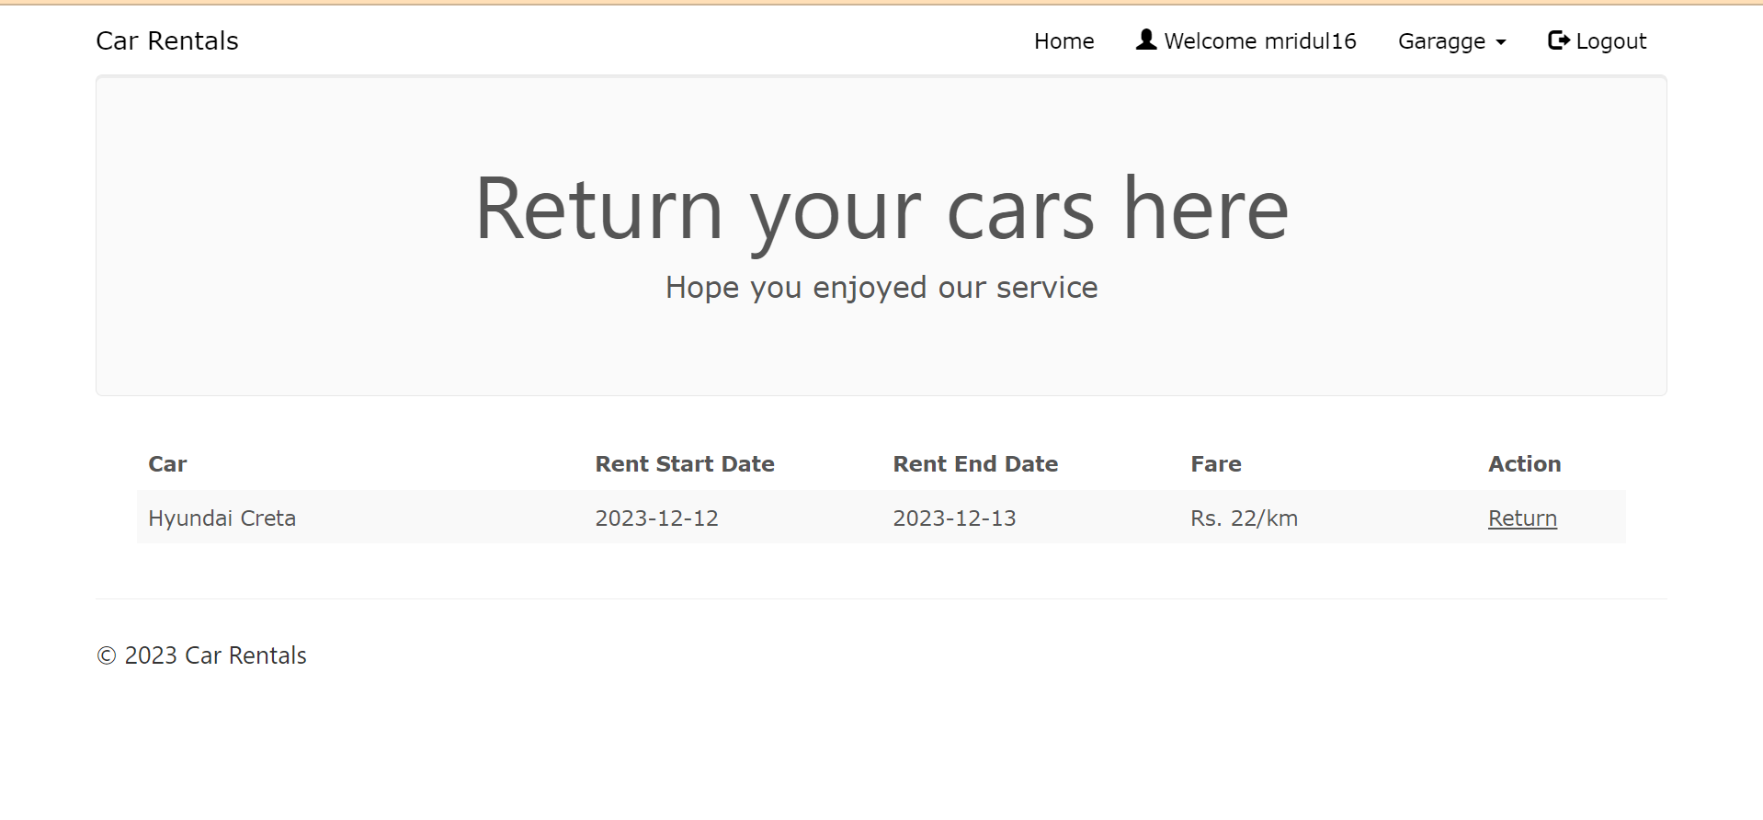
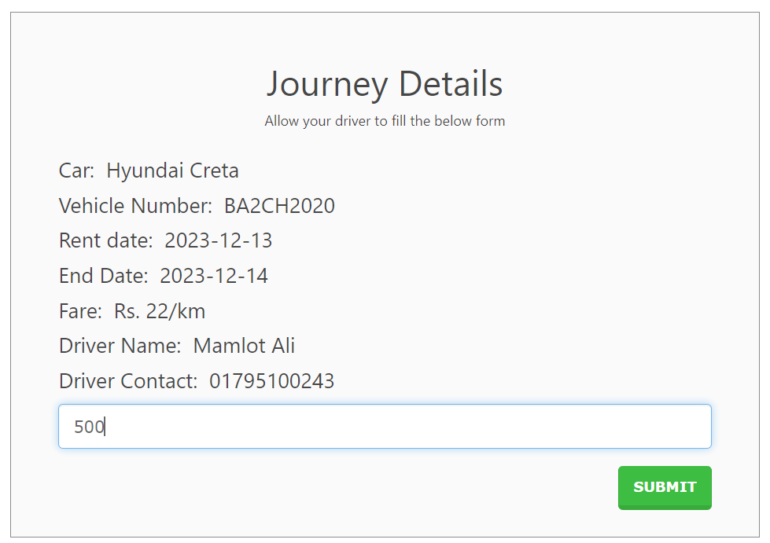
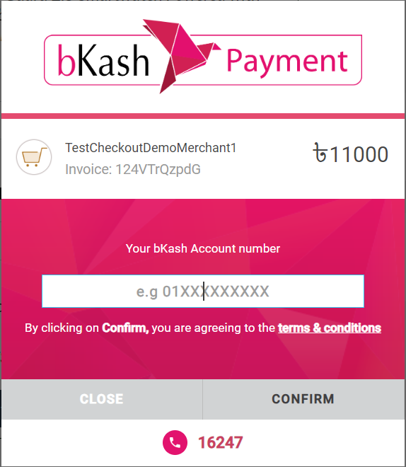
Car Rental :: Returned Page

Slide 10
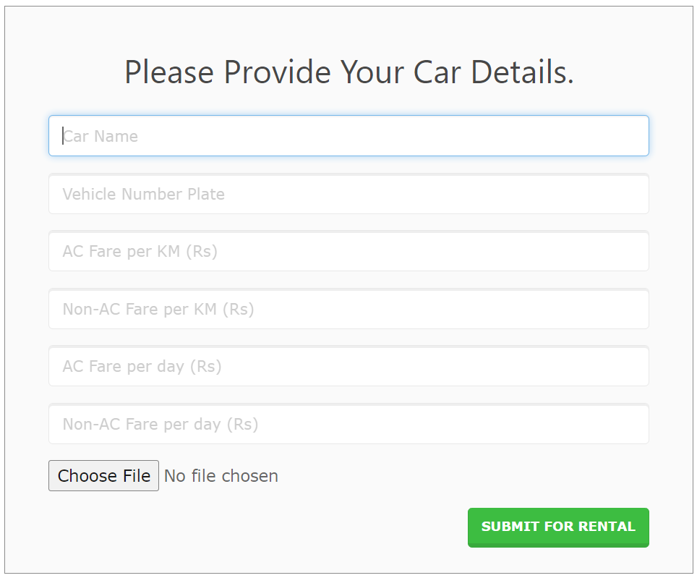
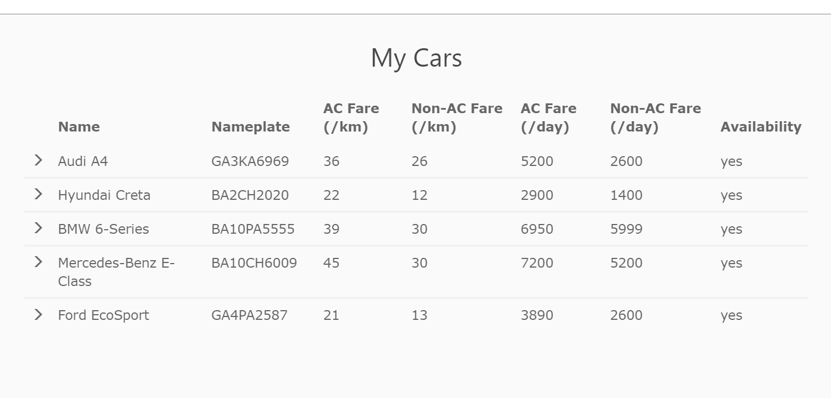
Car Rental :: Add Car

Slide 11
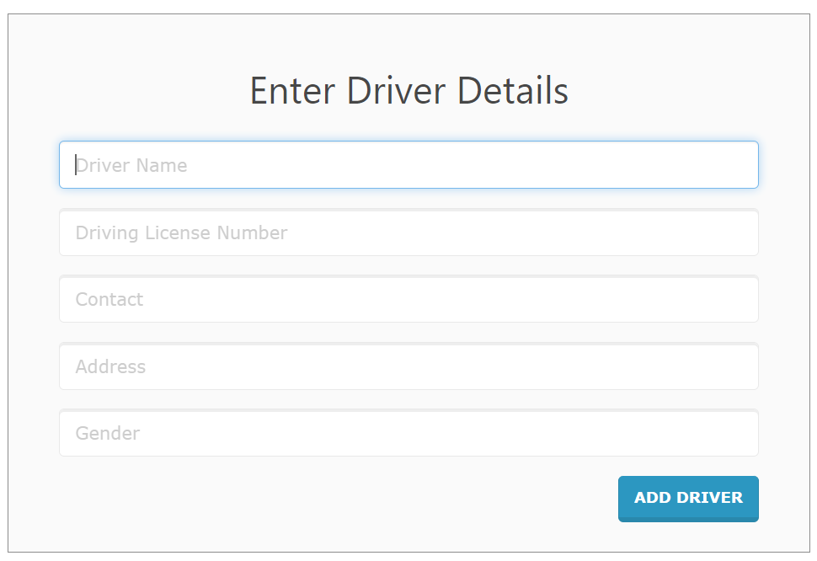
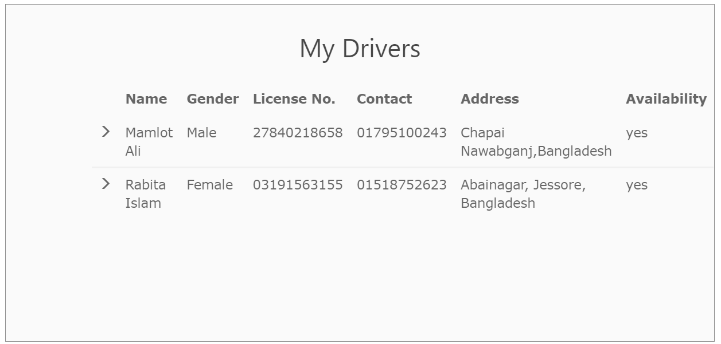
Car Rental :: Add Driver

Slide 12
Home FTP
Thank You

